Slide 1
Reflection and Renewal on the Labyrinth at Rosh Hashanah (Jewish New Year)

Slide 2
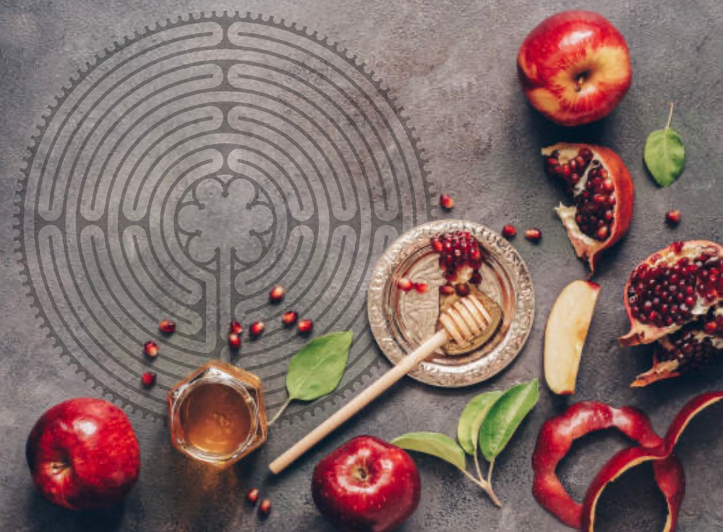

Slide 3
The High Holy Day of Rosh Hashanah (meaning: Head of the Year) marks a time of Reflection and introspection as we review our actions during the past year. It also marks a time for the Renewal of our commitment to improve ourselves and our communities as we move together into the new year.

Slide 4
Rosh Hashanah reflects the values of Presence, of Gratitude, and of Hopefulness within each individual and within the community. The traditional Hebrew greeting of “shanah tova u’metukah!” (wishes for a good and sweet new year) is shared with others, and symbolic foods are enjoyed together. These include:

Slide 5
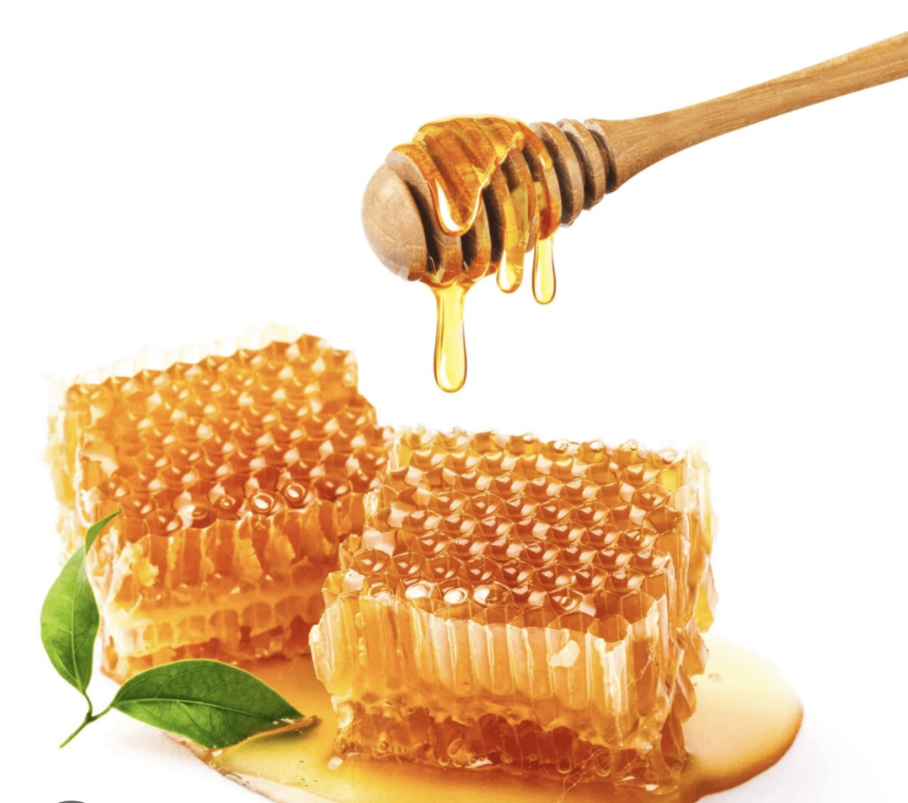
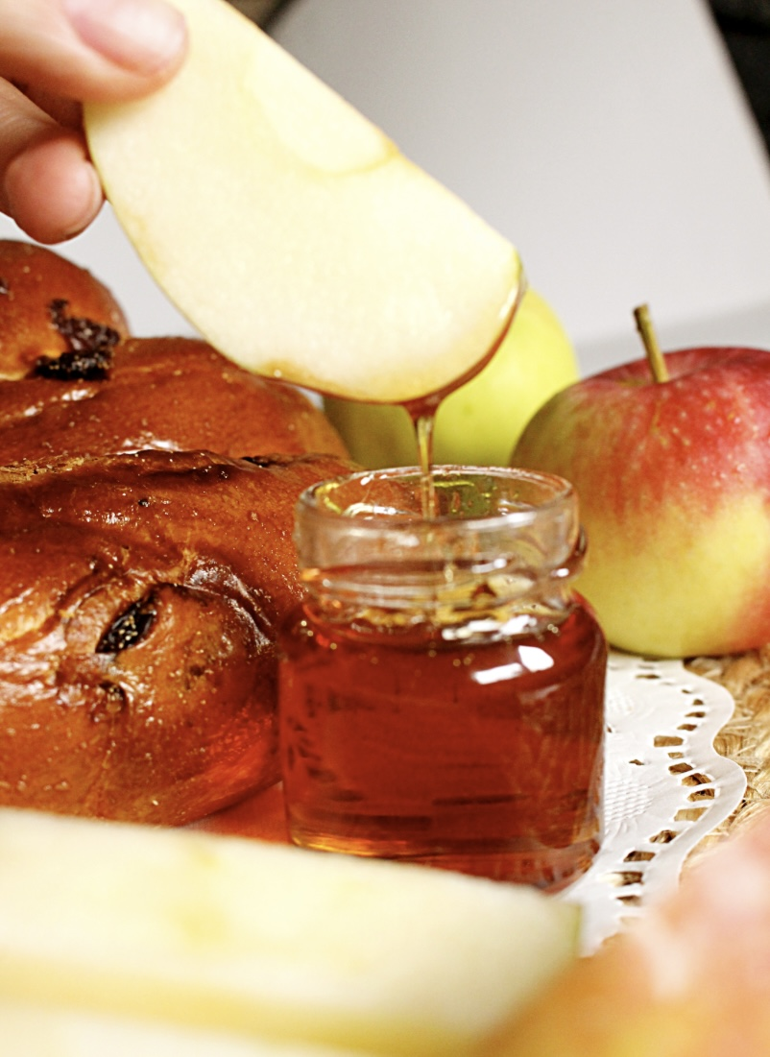
Sweet Honey and Apples

Slide 6
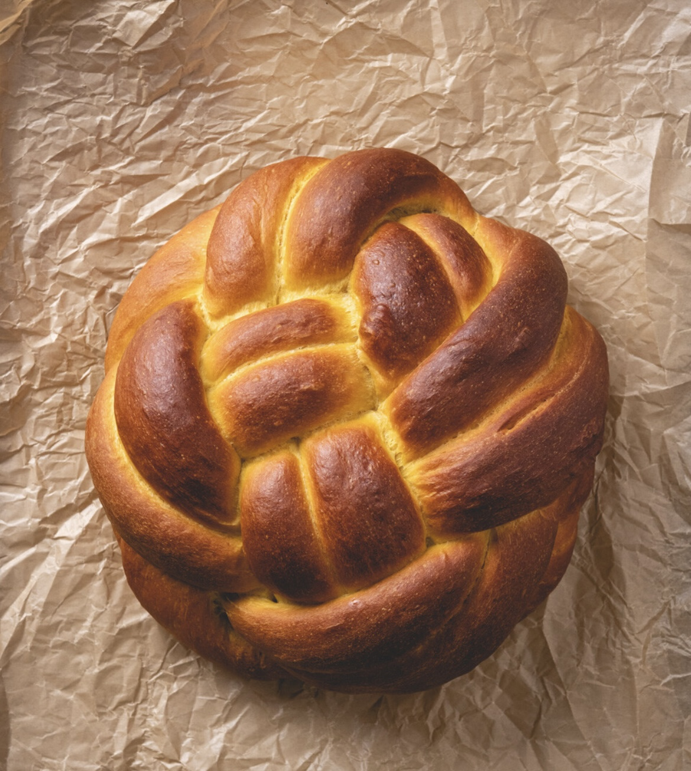
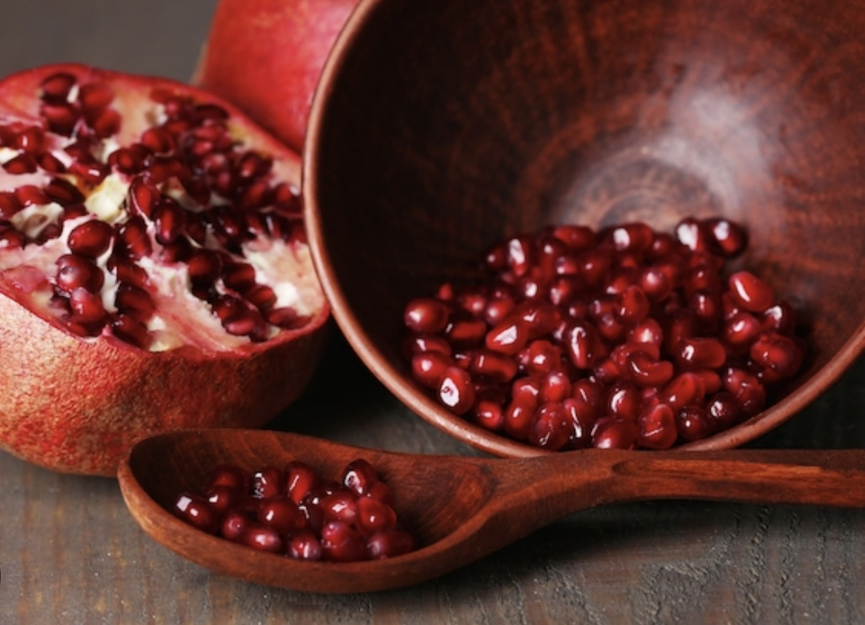
Pomegranates and Challah

Slide 7
In addition to Reflection and Renewal as important values highlighted at Rosh Hashanah, it is also understood as a time of Repentance – of turning away from and releasing the sins and wrong-doings of the past year, leading up to Yom Kippur (the Day of Atonement) at the conclusion of the Ten Days of Repentance. This repentance is marked by the ritual of Tashlich – the symbolic casting away of wrong deeds into the moving water of a river or sea where they disappear forever.

Slide 8
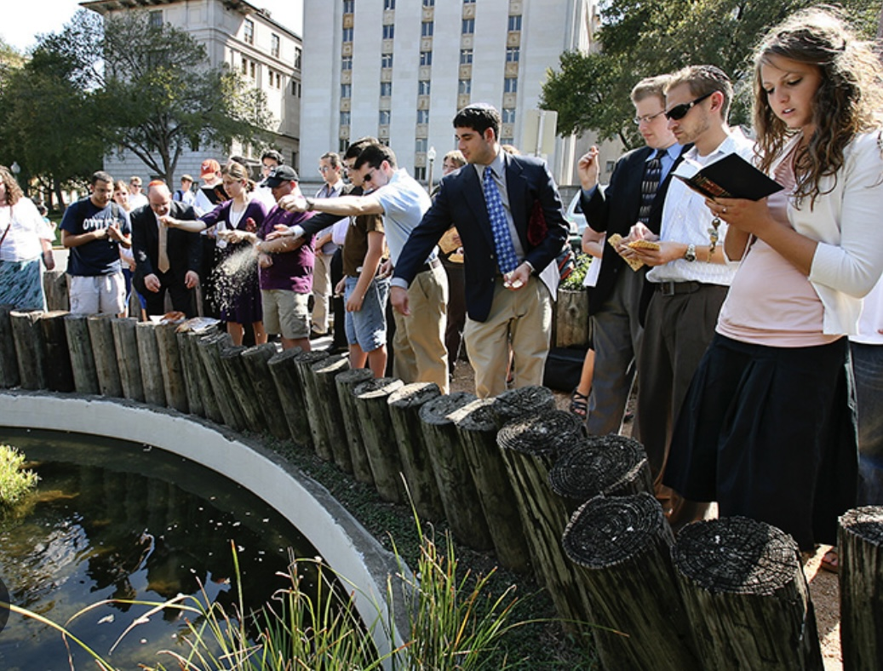

Slide 9
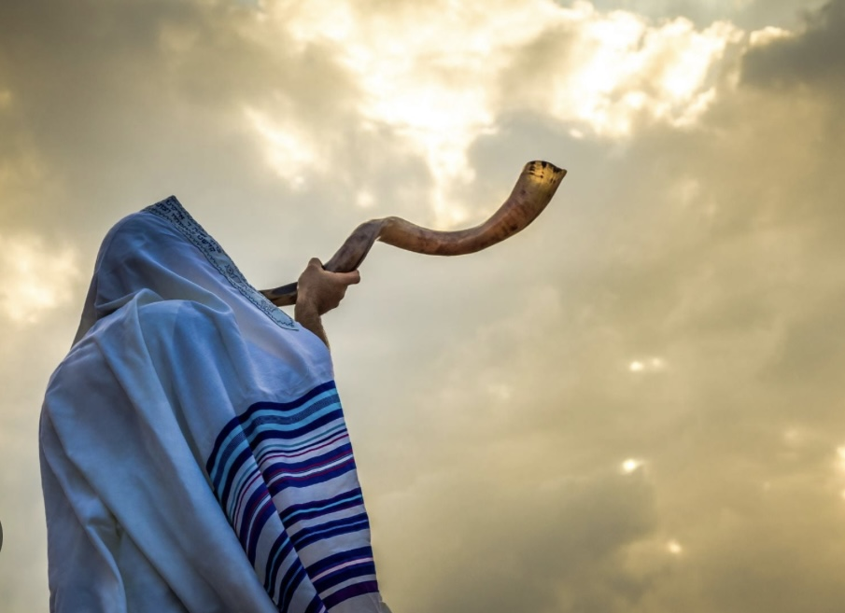
The Shofar (ram’s horn)

Slide 10
The Shepherd and His Flute – A Tale of the Ba’al Shem Tov (Joanie Calem)

Slide 11
